Slide 1
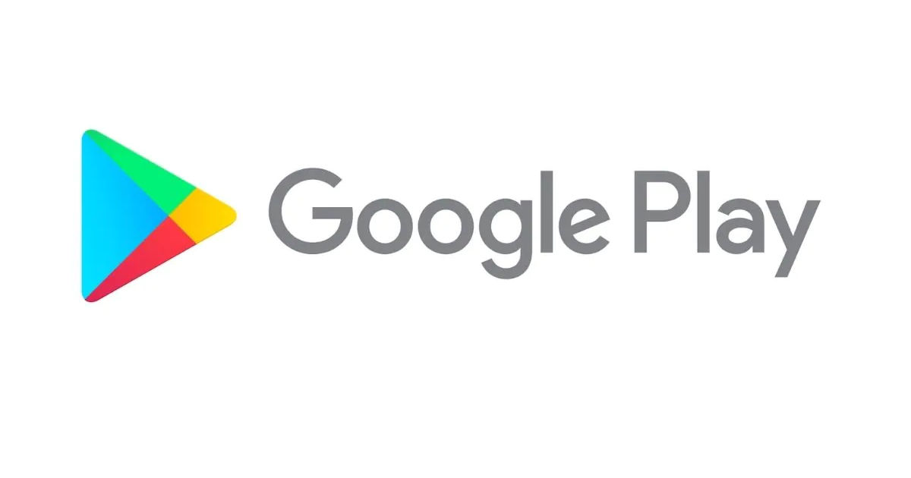
Capstone Project - 1 Play Store App Review Analysis Team members Satyam Jyoti Sankar Krushnagopal Brahma

Slide 2
Content
Introduction
Problem definition
Description of Dataset
Data cleaning
Data Analysis & Visualization
Important points get after Data visualization
Work on Sentiment Analysis (2nd Data Set)
Conclusion

Slide 3
Introduction
Android is the most popular operating system in the world, with over 2.5 billion active users spanning over 190 countries.
Google Play was launched on March 6, 2012, bringing together Android Market marking a shift in Google's digital distribution strategy .
Android is the dominant mobile operating system today more than 85% of all mobile devices running Google’s OS. The Google Play Store is the largest and most popular Android app store.
There are more than 3.04 million apps found on Google Play Store

Slide 4
Introduction
The Play Store apps data has enormous potential to drive app-making businesses to success. Actionable insights can be drawn for developers to work on and capture the Android market.
The main goal of our project is-
The purpose of our project is to gather and analyze detailed information on apps in the Google Play Store in order to provide insights on app features and the current state of the Android app market.
The Objective of the project to Explore and analyze the data to discover key factors responsible for app engagement and success.

Slide 5
Problem Statement:
What are the top categories on Play Store?
Are majority of the apps Paid or Free?
How importance is the rating of the application?
Which categories from the audience should the app be based on?
Which category has the most no. of installations?
How does the count of apps varies by Genres?
How does the last update has an effect on the rating?
How are ratings affected when the app is a paid one?

Slide 6
Description of Dataset:
There are two dataset: Play Store Data & User data
1) Play Store Data:
App : The name of the app
Category : The category of the app
Rating : The rating of the app in the Play Store
Reviews : The number of reviews of the app
Size : The size of the app
Install : The number of installs of the app
Type : The type of the app (Free/Paid)
The price of the app (0 if it is Free)

Slide 7
Description of Dataset:
content Rating :The appropriate target audience of the app
Genres: The genre of the app
Last Updated : The date when the app was last updated
Current Ver : The current version of the app
Android Ver : The minimum Android version required to run the app

Slide 8
Description of Dataset:
2)User Review Data:
App – An app name
Sentiment – Sentiment given to an app by users ( i.e Positive, Neutral, Negative)
Sentiment Polarity – The polarity of sentiment measures how negative or positive the context is. In the data we have, the polarity ranges from +1(Positive) to -1(Negative).
Sentiment Subjectivity - The subjectivity of a sentiment is how likely that sentiment is to be based on data or factual information, versus personal opinions or public notions

Slide 9
Data Cleaning:
Data cleaning is not just a case of removing erroneous data, although that’s often part of it. The majority of work goes into detecting rogue data and (wherever possible) correcting it.
Data Cleaning Step:
Removing unwanted observation: Duplicate/redundant or irrelevant values deletion.
Missing Data handling: Fixing issue of unknown missing values.
Structural error solving: Fixing problems with mislabeled classes,datatype names of features, same attribute with different name etc.
utliers management: Unwanted values which are not fiting in datasets.

Slide 10
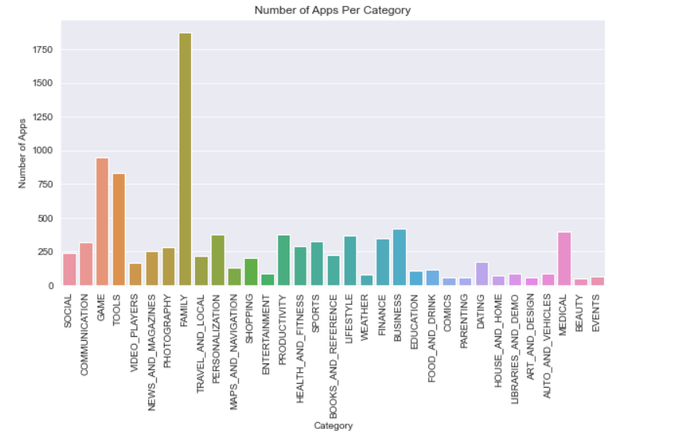
Data Analysis & Visualization:
In fast part we create the bar plot which show the no of app present in play store in category basis.
Here we see that there are highest no of app in play store from family category. In second there is game then tools.

Slide 11
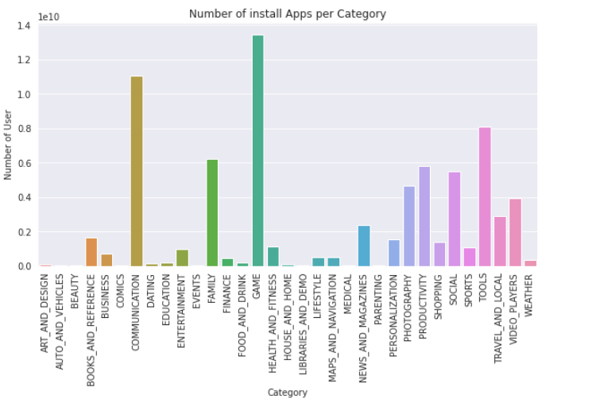
Data Analysis & Visualization(cont..):
It’s a very imp visualization which shows us which category app create more interest among people its calculate total no of installation from each category.
From the graph we conclude that most user showing there interest in Gaming app and after game people show there interest in communication apps. The highest install app is Game app and communication app is in second.

Slide 12
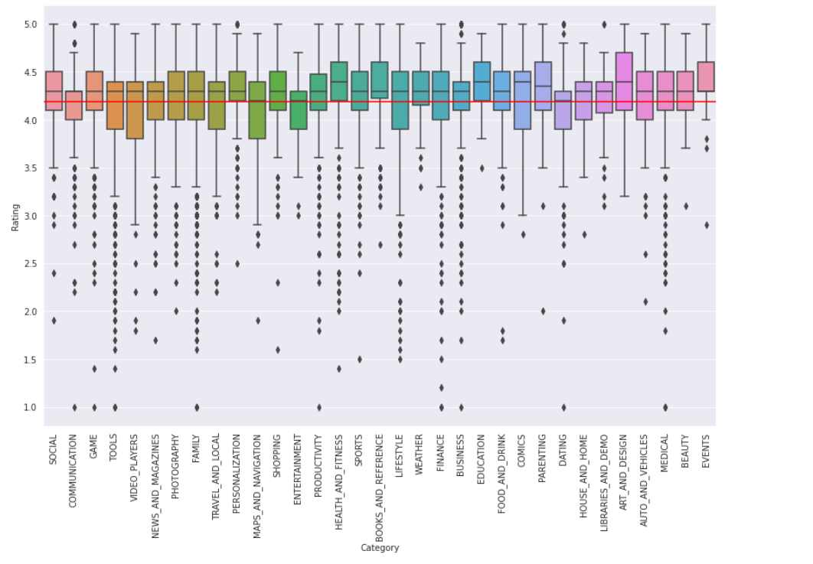
Data Analysis & Visualization(Cont.)
This graph shown rating given by user from each category app .
Here we see that Performance of all app categories is mostly Decent. Highest quality apps with 50% apps with a rating higher than 4.5 are Health and Fitness and Book and Reference app. This is considered to be extremely high!
However, the apps in Dating category having lower rating than the average ratings is 50%.

Slide 13
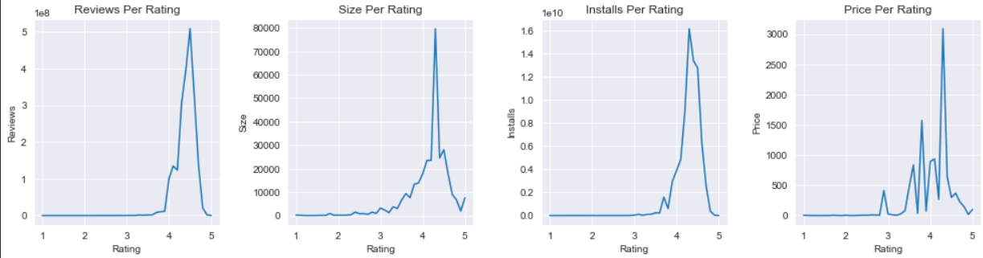
Data Analysis & Visualization:(Cont.)
This graph is a correlation graph which show how rating varies in different condition and scenario.
From this graphs, we found that most of the apps whose rating range is in between 4.0 - 4.7 are having high amount of reviews, size, and installs. In terms of price, it doesn't reflect a direct relationship with rating, as we could see a fluctuation in term of pricing even at the range of high rating

Slide 14
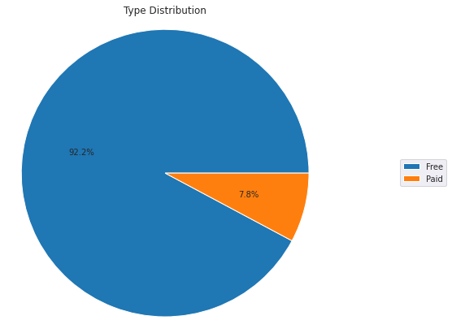
Data Analysis & Visualization:(Cont.)
Here we see what is the percentage off free app and paid app in play store.
Here we see from all app 92.2% app are free app and only7.8% app are paid app.

Slide 15
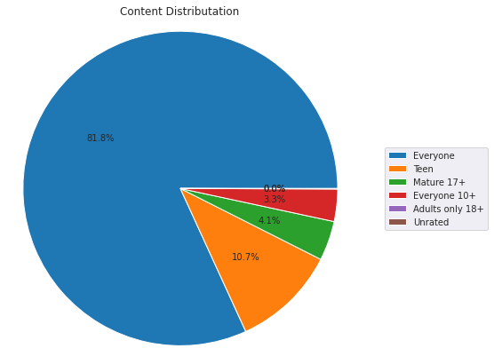
Data Analysis & Visualization(Cont.)
Here the graph show different type content , it show the app is applicable for which category people.
Almost 82% app is for everyone and in next 10.7% for teen.

Slide 16
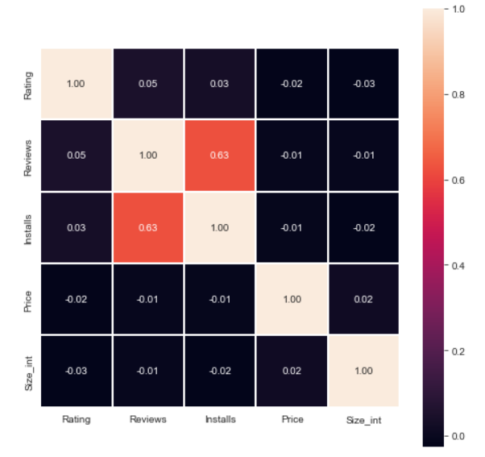
Data Analysis & Visualization:(Cont.)
It is the most important graph in our visualization , it’s a graph of correlation with each factor compare relation with other factor.
Here we get that, Installs and review are highly corelated to each other.
We get a moderate positive correlation of 0.63 exists between the number of reviews and number of installs. Which show who, load an app usually also leave back a review or feedback.
So, getting your app reviewed by more people maybe a good idea to increase your app's capture in the market!

Slide 17
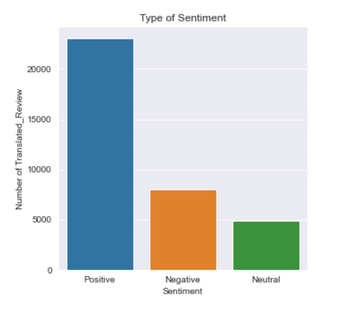
Data Analysis & Visualization:(Cont.)
Now in 2nd part of visualization we see the sentiment review whish show us type of reaction of people.
From the 1st sentiment graph we notice that most of the people positive review in compare to negative .

Slide 18
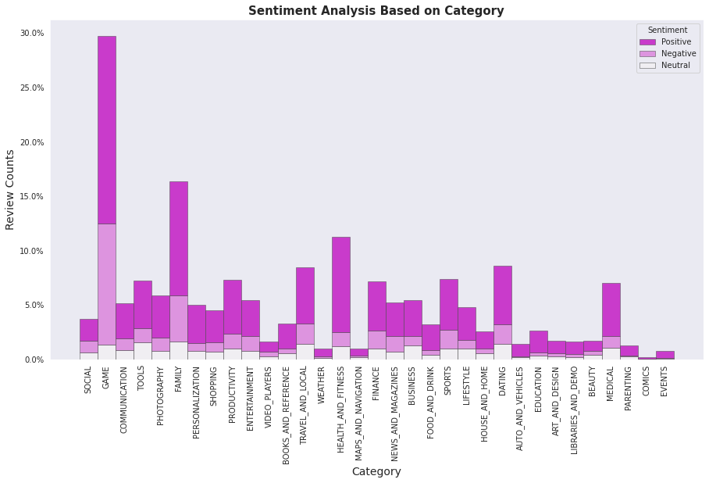
Data Analysis & Visualization:(Cont.)
Here we conduct the graph which show type sentiment analysis from each category . This graph help us to know which category get highest sentiment review as well as compare of +ve and -ve review .
Family, Sports and Health & Fitness apps perform the best, Having more than 50% positive reviews and Game and Social apps perform decent leading to 50% positive and 50% negative.
The number of review of game is much more higher in compare to other.

Slide 19
Some important question cover after Data Visualization:
Data distribution on basis of no of review .
Total no of installation from each category .
Top 5 apps on the basis of highest installs.
Top 5 most reviewed app by user .
The top 5 expensive apps in play-store.
we check top 5 most installed game.
5 apps from the 'FAMILY' category are having the lowest rating.
Top 5 app which get Most translated_review.
Top 5 category which get most translatated review?

Slide 20
Some important points we get:
Average rating of (active) apps on Google Play Store is 4.17.
If we see individually app wise the communication app like facebook and whatsapp get highly reviewed app it shown that people regularly active on that and give there feedback also on that.
.Medical and Family apps are the most expensive and even extend up to 80$.
.Users tend to download a given app more if it has been reviewed by a large number of people.
.More than half users rate Family, Sports and Health & Fitness apps positively. Apps for games and social media get mixed reviews, with 50 percent positive and 50 percent negative responses.

Slide 21
Conclusion
The Google Play Store Apps report provides some useful details regarding the trending of the apps in the play store. As per the graphs visualizations shown above, most of the trending apps (in terms of users' installs) are from the categories like GAME, COMMUNICATION, and TOOL even though the amount of available apps from these categories are twice as much lesser than the category FAMILY but still used most.
The trending of these apps are most probably due to their nature of being able to entertain or assist the user. Besides, it also shows a good trend where we can see that developers from these categories are focusing on the quality instead of the quantity of the apps

Slide 22
Conclusion
Other than that, the charts shown above actually implies that most of the apps having good ratings of above 4.0 are mostly confirmed to have high amount of reviews and user installs.
The size and price shouldn't reflect that apps with high rating are mostly big in size and pricy as by looking at the graphs they are most probably are due to some minority. Futhermore, most of the apps that are having high amount of reviews are from the categories of SOCIAL, COMMUNICATION and GAME like Facebook, WhatsApp Messenger, Instagram, Messenger – Text and Video Chat for Free, Clash of Clans ,google apps etc.

Slide 23
Conclusion
Even though apps from the categories like GAME, SOCIAL, COMMUNICATION and TOOL of having the highest amount of installs, rating and reviews are reflecting the current trend of Android users, they are not even appearing as category in the top 5 most expensive apps in the store .
As a conclusion, we learn that the current trend in the Android market are mostly from these categories which either assisting, communicating or entertaining apps.

Slide 24
Thank You…

